Slide 1
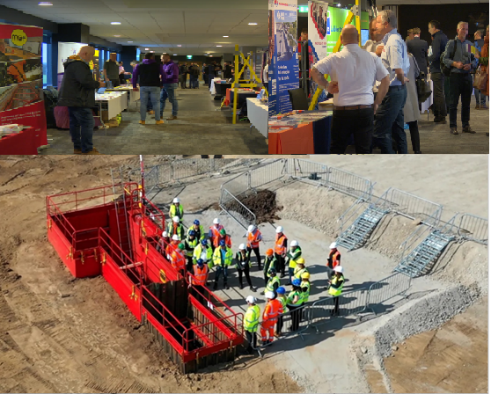
Construction Health & Safety Expo
Grand Hotel Gosforth Park, High Gosforth, Newcastle upon Tyne NE3 5HN
Tuesday, 14th October 2025

Slide 2
Construction Health & Safety Expo
This event is run by the industry for the industry as part of the UK-wide Working Well Together (WWT) campaign.
HSE’s primary objective is to reduce work-related ill health, with a specific focus on mental health and stress.
Work-related health conditions can be mentally and physically devastating for workers and their families. Disabled workers or workers with long-term health conditions can be excluded if workplace risks are not managed appropriately.
This event aims to stimulate preventative action on work-related ill health, focusing on the benefits of tackling risks to workers’ health and the significant costs to both businesses and society when these risks are not effectively managed.
This event is aimed at company owners, directors and senior managers and supervisors.
Cost: £35 per person and includes buffet lunch
Places will be offered on a first-come, first-served basis.
BOOK NOW!
PLUS visit our FREE construction exhibition
OPEN ALL DAY

Slide 3






Construction Health & Safety Expo

Slide 4
Construction Health & Safety Expo
08.00 - 08.45 Registration & tea/coffee
08.45 – 08.50 Introduction
Jason Anker MBE – Proud 2b Safe
10.00 – 10.30 Break
Anthony Hutton – Never Throw the Towel in Project
John Heslop – Health & Safety Executive
12.00 – 13.00 Lunch
Bob Vine – Addex Group
Matt Greenly – Health & Safety Executive
14.10 – 14.40 Break
Nick Forte - Arco
15.20 – 15.40 Q&A & Close

Slide 5
Construction Health & Safety Expo
10th October 2025
0203 028 2615
debbie.flynn@hse.gov.uk
Construction Health & Safety Expo Tickets, Tue, Oct 14, 2025 at 8:30 AM | Eventbrite

Slide 6












Construction Health & Safety Expo
For information on the Working Well Together campaign:
Working Well Together | CONIAC

